Slide 1
Send information Report
Welland Academy
Written July 2024
Reviewed September 2025
Next Review September 2026
SENDCo: Mrs K Black
This report explains how Welland Academy support pupils with Special Educational needs and require additional support to access learning.

Slide 2
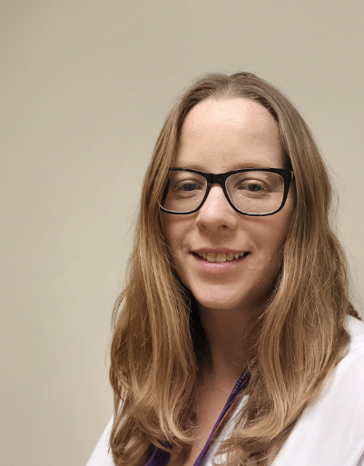
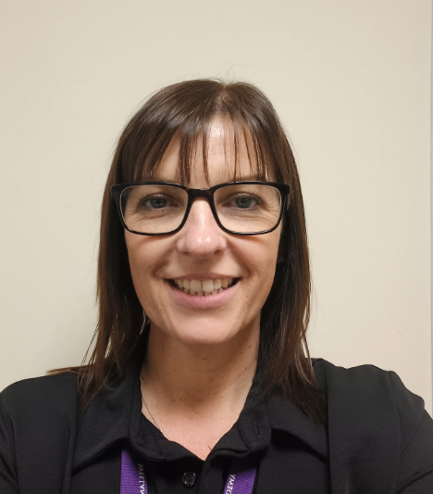
Who will support my child
Our SENDCo is
Mrs Kathryn Black.
Mrs Black works
4 days a week to
manage The SEND
Provision and teaches
1 day a week.
The Assistant SENDCo
is Nicola McCombe.
Class teachers: All of our class teachers receive in-house SEND training and are supported by the SENDCo. External agencies support school adults where personalized strategies are needed to support individual pupils.
Teaching assistants (TA’s): We have 14 TA’s who support in classrooms and deliver interventions such as : Daily reading, sensory circuits and attention autism.

Slide 3
The type of Special educational needs we support at Welland Academy.
Communication and interaction. | Cognition and learning | Social emotional and mental health | Sensory and/or physical
Autism Spectrum Condition Speech and Language Difficulties Global developmental delay | Specific learning difficulties Including dyslexia dyspraxia and dyscalculia. Moderate learning difficulties. Sever learning difficulties Genetic conditions | Attention deficit hyperactive disorder (ADHD). Attention deficit disorder. Trauma and adverse childhood experiences. | Hearing impairments Visual impairments Multi-sensory impairments Physical impairments.

Slide 4
External agencies
Sometimes we will make referrals to outside agencies to ensure our pupils are receiving the right support. Referrals need parent/carer permission.
External agencies can include:
Speech and language therapists
Educational Psychologists
Occupational Therapist
Pediatricians
School nurse
Mental health specialists
School hubs
Behaviour specialists
Specialist Teachers

Slide 5
What should I do if I think my child has SEND.
Speak to your
child's class teacher.
Meet with the SENDCo to discuss concerns and outcomes
If it is decided your child needs additional support in school which is different to their peers, they will be added to the register of additional support.
All our class teachers are aware of SEND and will identify any pupils who are not making expected progress.
The Class teacher will put in place interventions to support the pupil to make progress.
If the pupil does not make expected progress the class teachers will discuss the pupil’s progress with the SENDCo.
The SENDCo will complete observation of the pupil, look at their assessment data, attendance, class work and meet with parent/carers.
If it is decided your child needs additional support to make progress they will be placed on the register of additional support.

Slide 6
The register of additional support-Provision overview.
Whole school approach | Wave 1 | Wave 2 | Wave 3
Provides appropriate learning opportunities for all pupils at Welland Academy. These adaptations and reasonable adjustments include: Scaffolding/modelling and writing frames. Effective questioning and feedback. Visual prompts. Flexible groupings and talking partners. | If a pupil has receive approaches outlined in the whole school approach, targeted SEND support is needed. A learning plan or class support plan will be created. Provision can include: Intervention groups for English and Maths. Interventions for Speech and Language. Intervention to support with social times of the day. Precision teaching Daily reading. Sensory Circuits. Chunked learning | If wave 1 is not sufficient to meet a pupils needs, specialist send support can be requested with parent/carer permission. Provision can include referrals to: An Educational psychologist. Speech and Language team, (SALT). ELSA support Occupational Therapy. Specialist teaching team. Provision is addition to wave 1 and whole school approach: Consistent Small group teaching. Personalised interventions Heavily Adapted learning. | If a pupil needs support above wave 2, an request for an Education Health and Care Plan (EHCP) can be requested. If an EHCP is awarded, the provision a pupil needs will be outlined in this document.

Slide 7
How do I know if the support for my child is having an impact.
Class teachers and possibly the SENDCo will also monitor your child’s work books, attitude to learning and scores in test, impact of interventions.
This will be discussed when you meet with the class teacher.
An in-class support plan or a learning plan can be created for your child if needed.
Learning plan:
This is a targeted approach to support to monitor progress where progress has slowed and successful strategies are being identified. Specific targets and relevant support is implemented, this is then monitored to identify the progress your child makes and the success of the additional support.
In class support plan:
This allows for strategies to be implemented consistently where your child needs specific support to access learning e.g if your child is hearing impaired, they may need access throughout their school to a sound system.

Slide 8
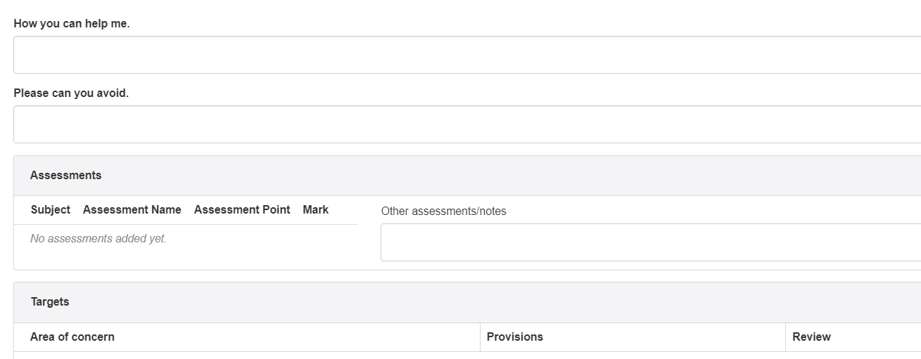
In class SEND support plan.
SEND progress is monitored via a class support document. This outlines the provision a pupil needs as part of wave one. This plan is updated when needed. Class Teachers will discuss the pupils progress at parents evening and in school reports.

Slide 9
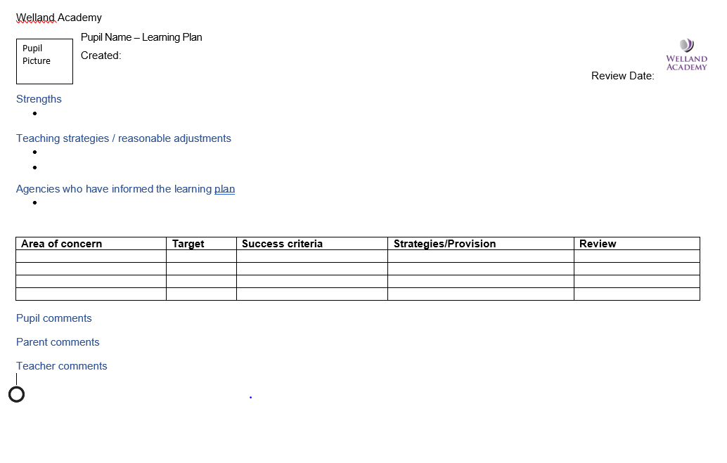
Learning Plan

Slide 10
Learning support plan.
Assess
We will gain a full understanding of the strengths and needs of the pupil, using data, observations, pupil and parent/carer voice to inform this.
Review
We will assess the impact of the support which has been put in place. We will use this information to adapt targets and improve provision
Plan
We will create targeted plan of support will be created.
Do
We put the plan into place. The class teacher with support from the SENDCo will be responsible for overseeing the plan.

Slide 11
How will I be involved in decision about my child.
I will be given opportunities to meet with my child's class teacher 3 times a year. In these meeting the class teacher will discuss:
your child' s progress towards the targets which have been set.
Future targets
Strengths and additional needs.
It is important to have a consistent approach between parent/cares and school. This is also an opportunity to discuss parental/carer concerns and strategies implemented at home to support your child.
If you have any concerns between these meetings, please arrange a meeting with your child’s class teacher via the office. Email:admin@wellandacademy.org
How will my child be involved in decisions made about their education.
Your child’s views on their targets, learning, their strengths and needs will be collected through pupil voice. This will be completed in a way that suits your child and could include, a conversation, questionnaire sorting activity.

Slide 12
Area of need | Condition | Support
Communication and interaction, including: Pupils who have difficulties communicating and interacting with peers and adults. | Autism Speech and language | Social stories, comic book conversation, visual prompts, attention autism intervention, work trays, sensory circuits Language and speech link intervention, visual prompts, NHS speech and language intervention, in class modelling and support, TACPAC.
Cognition and learning | Learning difficulties | Daily reading, Adapted learning, In class support, Lexia, Topic specific intervention Visual prompts, movement/sensory breaks, chunked learning, scaffolded learning, strategies to reducing the information held in the working memory.
Social, emotional and mental health (SEMH) Including: difficulties in concentrating and focusing, remembering information, regulating emotion. | ADHD, Adverse childhood experiences and/or mental health issues | Social stories, comic book conversations, movement and/or sensory breaks, reduce information held in the working memory, visual prompts, sensory circuits. Elsa, support from the mental health team if appropriate, incredible 5 point scale, understanding emotions interventions, social interactions intervention.
Sensory and physical | Hearing impairment Visual impairment Multi-sensory impairment Physical impairment | Sitting close to the class teacher, looking towards the pupil when speaking, strategies from specialist teachers. Enlarged font, strategies from specialist teachers. As above Writing slope, fine motorskills intervention, handwriting intervention, strategies recommended by occupation therapist/physiotherapist, sensory circuits

Slide 13
Welland academy will cover costs within the notational budget, this can include in class intervention, resources and equipment.
If further funding is needed to support your child, Welland Academy will discuss with parent/carers to potential to request an Education Health and Care Needs assessment with the Local Authority. Advice from outside agencies will be sort.
How will resources be secured for my child?
How will my child be included into all school activities.
Pupils with SEND are able to participate in all school activities. To be able to access these activities additional support may need to be implemented.
All pupils are able to participate in extra-curricular activities.
All pupils are encouraged to go on academy trips.
All pupils are encouraged to take part in academy activities including sports day
SEND pupils are represented on the school council.

Slide 14
Enhanced provision
To meet an increasing level of need across the academy, we have developed an internal enhanced provision to ensure that we continue to make special educational provision for all needs, whilst working towards ensuring that they can thrive in the wider society.
Criteria
Is non-verbal and/or not working at National Curriculum Levels.
Has an EHCP (EHCP pending) or is on the EHCP pathway.
Is unable to access the mainstream classroom.
Pupils will have access to a greater level of support, helping them to develop their communication and interaction skills and make progress with all elements of their learning. The enhanced provision is located in the academy where appropriate inclusion work can be developed. The classroom has sensory and outdoor spaces, as well as an accessible toilet. The provision provides opportunities for academic and play based learning.

Slide 15
Welland Academy admissions process for pupils with SEND.
For pupils without an EHCP
Welland academy does not excluded admittion for pupils with SEND. When needed a personlised transition plan to ensure they have a positive start at Welland Academy.
For pupils with an EHCP.
Peterborough Statutory Assessment Monitoring teams (SAMS) will liase with school via the consultation process to identify if we can meet the needs of your child. To do this we need to ensure all support strategies your child needs can be implemented. The result of this consultation will be shared with you via the SAMS team. It is always recommended that you discuss your child needs with the SENDCo as part of this process.

Slide 16
How does Welland Academy support pupils with SEND transition into and from Welland academy.
Transition into primary school.
Additional visits to the child's pre-school- meeting with key workers and observation of pupil.
Additional meeting with parent/carers to identify strength/ needs, likes and dislikes.
Additional 'quiet' visits to the reception class, 2/3 pupils are invited at a time to explore the classroom and meet key adults.
Transition into secondary school:
The autism outreach team support offered to all pupil with a diagnosis of Autism or ADHD. The ASC specialist teacher comes into school to meet with pupils to discuss how they were feeling about secondary school and complete personalized activities.
Additional visits to the secondary school.
Transition support in ELSA session where appropriate.
Additional meetings with the SEND team to discuss the needs of pupils.
Learning to read the secondary school timetable and being organised.
Transition between year groups
All pupils have access to a transition afternoon and where possible they meet their class teacher and explore their new classroom.
SEND pupils will be pre-warned of these changes, and have extra opportunities to spend time with their support adults.
Where appropriate personalized social stories will be created to explain this change.

Slide 17
Preparing pupils for Adulthood?
At Welland Academy we provide all our pupils with Strategies and experiences to start their preparation to adulthood including:
Introducing Higher education or employment;
Teaching children about using their voice.
Encouraging community engagement by facilitating trips into the local community, such as a trip to the library, parks, swimming pools, places of worship.
Further life skills such as road safety or using public transport;
Learning what it means to be a good friend.
Healthy living
With discussion with parent/cares, targets to support transition to adulthood can be included into learning plans and EHCP’s.

Slide 18
What support is in place for looked after and previously looked after children with SEND
Mrs Anderson (Principal) is the designated teacher for looked-after children and previously looked-after children.
Mrs Anderson will work with Mrs Black (SENDCo) to make sure that all teachers understand how a looked after or previously looked-after pupil's circumstances and their SEND might interact, and what the implications are for teaching and learning.
Children who are looked-after or previously looked-after will be supported much in the same way as any other child who has SEND. However, looked-after pupils will also have a personal education plan(PEP).We will make sure that the PEP and any SEND support plans or EHC plans are consistent and complement one another.

Slide 19
What support is available for me and my family.
If you have questions about SEND, or are struggling to cope, please get in touch to let us know. We want to support you, your child and your family.
To see what support is available to you locally, please have a look at
SEND Information Hub (Local Offer) | Peterborough City Council
The Special Educational Needs and Disability Information, Advice and Support Service (SENDIASS) offers impartial and confidential information, advice and support to parents and carers who have a child or young person with special educational needs (SEN) or a disability or have concerns that their child has special educational needs.
Cambridgeshire Online | SEND Information, Advice and Support Service (SENDIASS)
Below are some charities which may be able to offer support :
IPSEA
SEND family support
NSPCC
Family Action
Special Needs Jungle
Peterborough City Council (autism.org.uk)
Cambridgeshire and Peterborough Emotional Health and Wellbeing Service (cambspborochildrenshealth.nhs.uk)
Little Miracles - HOME (littlemiraclescharity.org.uk)

Slide 20
What should I do if I have a complaint about my child’s SEND support.
The Trust takes very seriously any concern or complaint about the education or other services we provide or about the conduct of our staff. We believe that by tackling concerns at the earliest possible stage it allows us to improve relationships, enhance learning, prevent issues escalating and reducing the number of formal complaints we receive. Complaints about SEND provision in our academy will be dealt with in accordance with our complaints policy and procedure which is available on the academy’s website.
You should exhaust all stages of our complaints procedure before considering any escalation to other agencies. To see a full explanation of suitable avenues for complaint, see pages 246 and 247 of the SEND Code of Practice.
If you feel that our academy has discriminated against your child because of their SEND, you have the right to make a discrimination claim to the first tier SEND tribunal. To find out how to make such a claim, you should visit:
Complain about a school: Disability discrimination - GOV.UK (www.gov.uk)
You can make a claim about alleged discrimination regarding:
Admission
Exclusion
Provision and education and associated services
Making reasonable adjustments, including the provision of auxiliary aids and services.

Slide 21

To arrange an appointment with your child's class teacher or a member of the send team please contact the office to do this:
Email: admin@wellandacademy.org
Phone number: 01733 563180

